Slide 1


IOT#BC
Studenti
Paolo Campanelli
Andrea Cataluffi
Prof.
Massimo Callisto De Donato

Slide 2
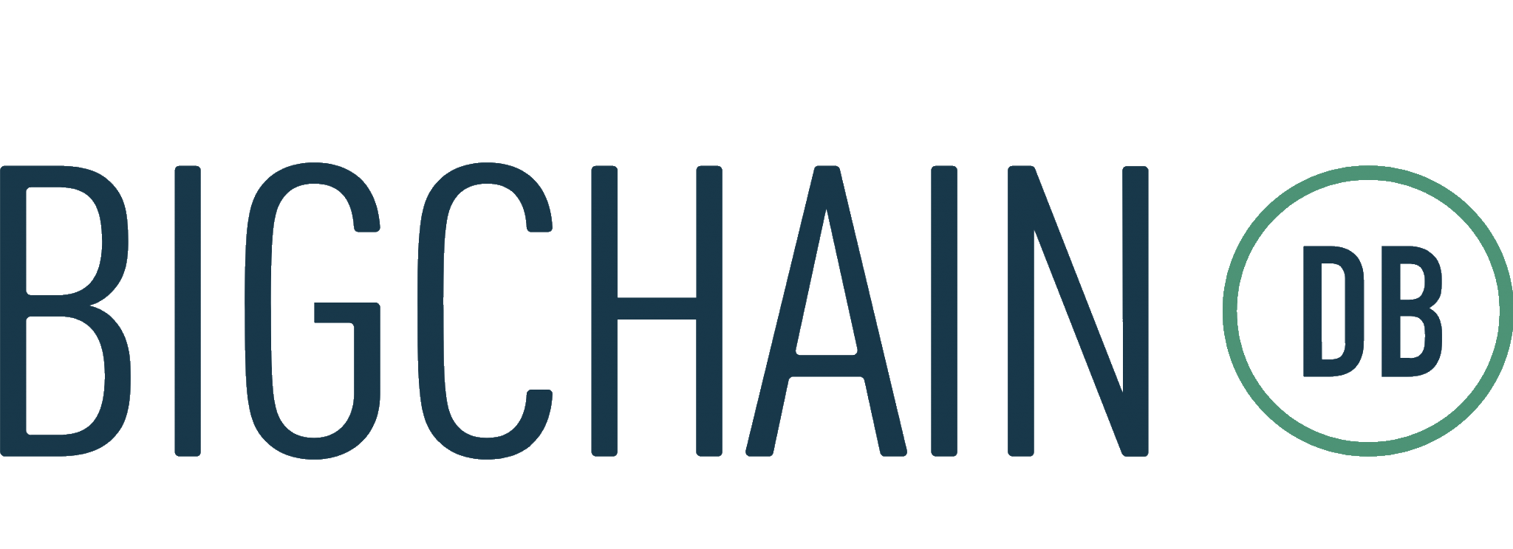
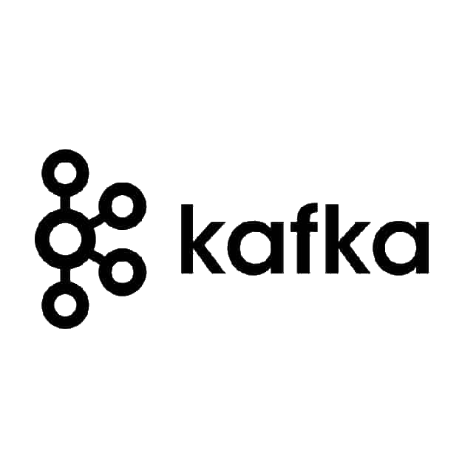
Objective
The objective of our project is to define a prototype tool to store IoT data on a blockchain database based on BigchainDB
In order to guarantee scalability and performance, we introduce an additional message broker component based on Apache Kafka

Slide 3
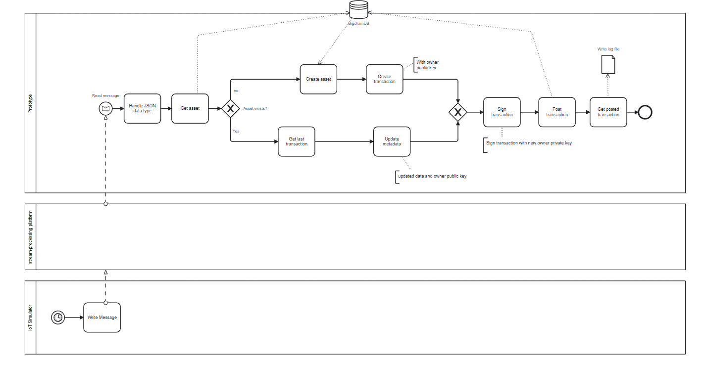
Architecture
IoT simulator (su Ubuntu 20.04)
Kafka (su Ubuntu 20.04)
NodeJs (su Ubuntu 20.04)
BigchainDB Server (su debian 11.0)

Slide 4
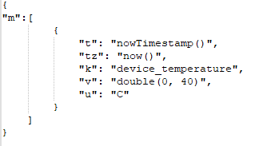
IoT Simulator
Used to simulate IoT devices that send JSON messages to the Kafka broker.
cd docker-compose
docker compose up

Slide 5
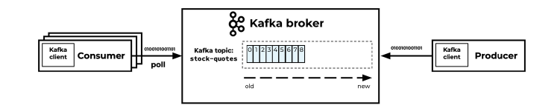
Kafka
Receives the JSON messages from the IoT devices and stores them in topics
Whether you are looking to process data from IoT devices, to handle data pipelines in big data processing applications, or to provide real-time data feeds for data visualization and analysis, Apache Kafka is a highly effective solution that is well-suited to meet your needs
Apache Kafka provides native support for MQTT, allowing MQTT data to be processed and stored using the Kafka platform.

Slide 6
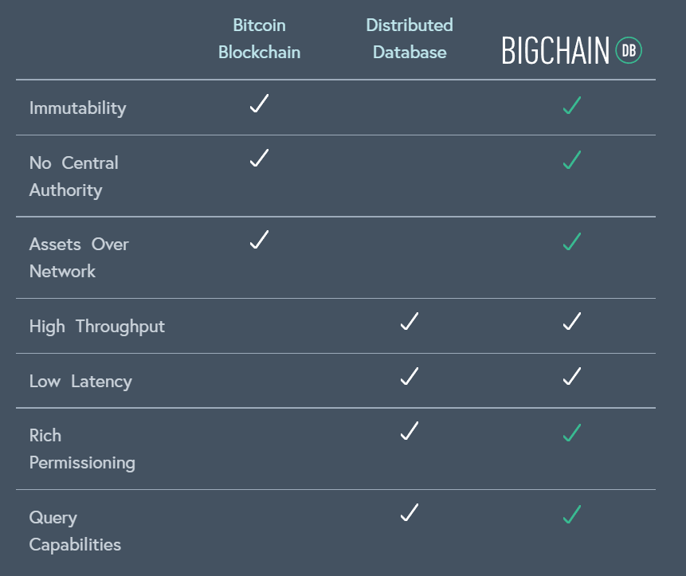
BigchainDB combines the key benefits of distributed database, MongoDB, and traditional blockchain
BigchainDB starts with a big data distributed database and then adds blockchain characteristics - decentralized control, immutability and the transfer of digital assets.

Slide 7
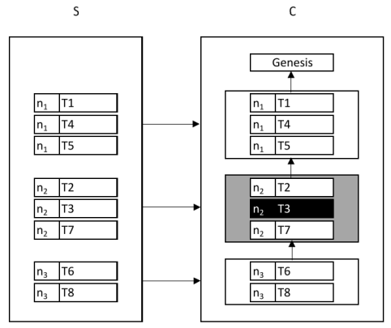
Transactions and Blocks
BigchainDB use the concepts of blocks and transactions
A Transaction contain generic information and can be used to create and transfer assets between customers
A Blocks are used to collect Transactions and are logically linked with previously generated blocks
Notes:
Database S, also known as transaction set or backlog. It collects the transactions generated by the clients and not yet validated.
Database C, also known as blockchain. It contains valid and invalid transactions, grouped into blocks logically linked to each other
Unlike the other blockchain platforms, blocks do not contain the hash of the previous block of the chain in their header. For each transaction contained in the block it is stored a reference to the previous block.
Each block contains a set of transactions that must be voted by the nodes of the network to decide if the content of the transactions can be considered valid or not.
The voting nodes attach to every transaction of the block the hash of the previous block of the chain. This is fundamental to demonstrate the transaction has been voted according to the current state of the blockchain, identified by the previous block.
White background blocks are valid blocks
Grey background are invalid blocks
Black background indicates an invalid transaction stored in C.
Backlog S contains 8 transactions (T1, T2,..., T8 )
Network is composed by three nodes, n1, n2, n3
The node n1 creates a block (block 1 ) containing the transactions T1, T4, T5.
The majority of nodes voted as valid these three transactions, and therefore the block 1 has been marked as decided valid.
Block 2 is created by node n2 and contains the transactions T2, T3 and T7.
The transaction T3 has been considered as invalid by the majority of nodes, so the correspondent block has been marked as decided invalid but it has not been removed from the chain of blocks
For this reason, the third block (block 3 ) contains a set transactions that refer to block 2 as the previous block of the chain. After the transactions have been inserted in valid blocks, they are removed from the backlog.

Slide 8
Not ACID But SALT
ACID referes to a set of guarantees for each transaction to be processed by the TP system: Atomicity, Consistency, Isolation, and Durability.
SALT is about Sequential, Agreed-on, Ledger, and Tamper-resistant transaction processing.
Notes:
Sequential : All Transaction are processed sequentially. Unlike with ACID transaction there is no parallel processing of transaction in the SALT model. However, just like the isolation property in ACID, all transaction in sequential order
Agreed-on : A Transaction is accepted when the majority of the network agrees on its valid. Community consensus determinies the system state, unlike in ACID,where it is solely controlled by a central authority
Ledger : All agreed-on Transaction are added to an append-only transaction ledger and cannot be revoked. State changes cannot be undone. This property is a bit weaker than the durability in ACID
Tamper-resistant : A Transaction cannot be manipulated or censored. Unlike the ACID there is no central access management so there are no privileged users which could alter or block pending transactions

Slide 9
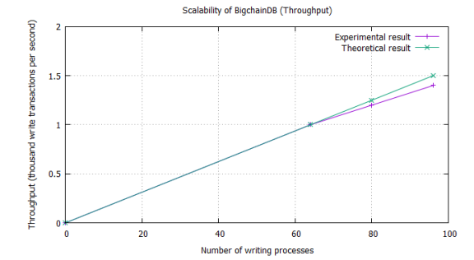
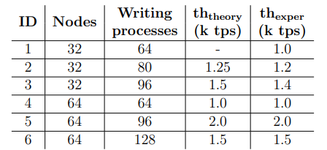
Throughput
The throughput of BigchainDB varies from 1000 to 2000 writing transactions per second, tests conducted on a cluster of 32 and 64 nodes.
The performances are strictly related to the number of processes simultaneously writing to the databases.

Slide 10
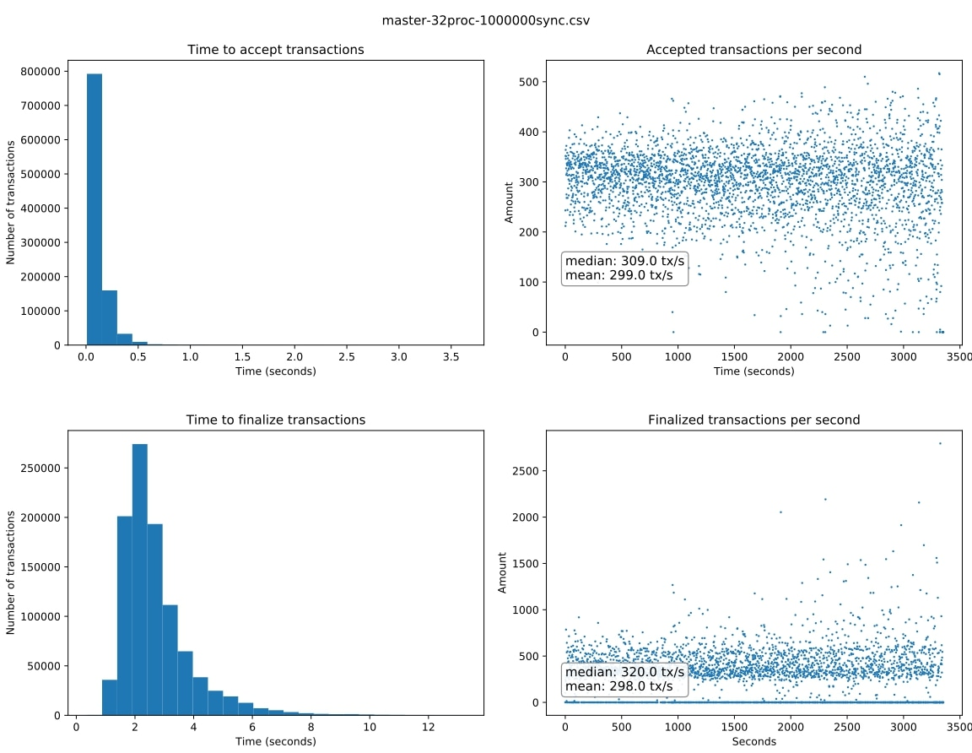
Throughput’s Experiment
One million transactions were processed in about 56 minutes without any failure.
99.7% of transactions were finalized within 9.392 seconds, 95% within 5.143 seconds, and 68% within 2.855 seconds.
The network finalized an average of 298 transactions per second, with a median value of 320 transactions per second.
All transactions were 765 bytes.
https://github.com/bigchaindb/BEPs/blob/master/23/README.md

Slide 11
Pros and Cons
Pros
High throughput.
Low latency.
Finality of transactions.
High storage capabilities (linearly dependent n the number of nodes).
Full-featured query language.
High performances in read-write operations.
Cons
Impossibility to write smart contracts.
Absence of Byzantine fault tolerance (crash-tolerant consensus algorithm)

Slide 12
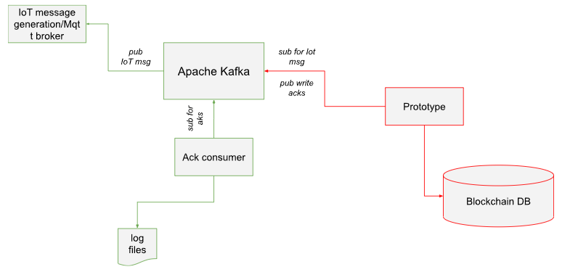
Prototype
It is created with NodeJS, you can launch it with Docker
How to run
docker-compose up

Slide 13
Libraries
AXIOS (version 1.3.2)
Bigchaindb-js-driver (version 4.3.0)
Config (version 3.3.9)
Kafkajs (version 2.2.3)
Notes:
Bigchaindb-js-driver 4.3.0 Official JavaScript driver for BigchainDB to create transactions in Node.js and the browser
AXIOS makes it easy to send asynchronous HTTP requests to REST endpoints and perform CRUD operations
Kafkajs A MODERN APACHE KAFKA CLIENT FOR NODE.JS
Config Node-config organizes hierarchical configurations for your app deployments.

Slide 14
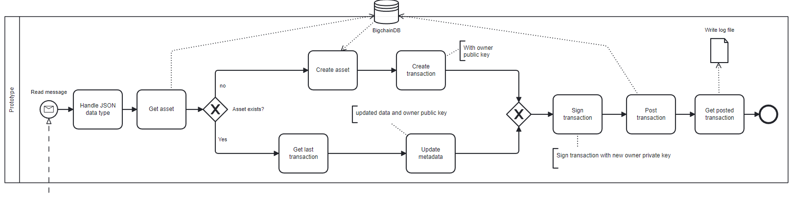
Logic
Notes:
This is the basic concept from which we started the implementation of our prototype.
First we format the data that is sent to us, then we take the asset corresponding to the data.
Whether the asset exists is evaluated. If it exists, it means that we definitely have a transaction already stored and consequently we will create a TRANSFER transaction.
Otherwise the asset is created and then a CREATE transaction is created.
Then transactions are signed with the private key and stored in BigchainDB, and a confirmation ACK is generated if the storage is successful.

Slide 15

Event Handling
Consume a message and, send it to the driver in order to create a transaction.
After that we can re-send a confirmation ACK of creating a new valid block to Apache Kafka topic.
https://github.com/tulios/kafkajs
Notes:
As we have already said, our purpose is to read high frequency data, store it in a blockchain and return a successful transaction confirmation ACK. The tool used is the KafkaJs library, A MODERN APACHE KAFKA CLIENT FOR NODE.JS This library has allowed us to create a consumer that, for each topic, reads and consumes messages and sends them to the service that will be responsible for creating and managing transactions. We also created a producer to manage the response ACK

Slide 16
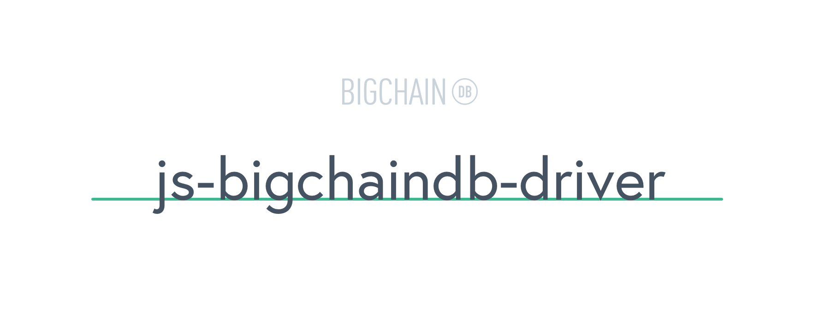
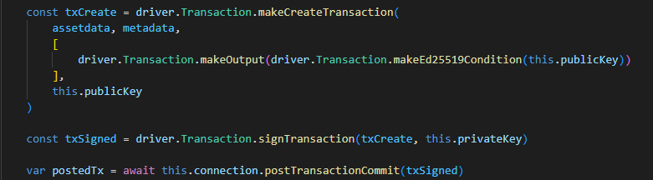
Transaction methods
Snippet to make a new CREATE transaction
https://github.com/bigchaindb/js-bigchaindb-driver
Notes:
This is an extract of code to show how a CREATE transaction is created.
We use the makeCreateTransaction method to build the payload transaction where we go to specify assets, metadata, transaction output and the owner’s public key.
ì
As we mentioned earlier the transaction then is signed with the owner’s private key.
We can eventually define our signature function but for our system it is not necessary.
After signing the transaction the connection with bigcahinDB is opened and the transaction post is made.

Slide 17
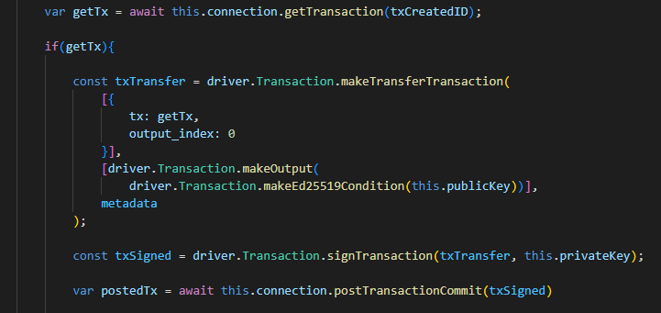
Transaction methods
Snippet to make a new TRANSFER transaction
https://github.com/bigchaindb/js-bigchaindb-driver
Notes:
In our case we do not have a real transfer of ownership of the transaction but simply a Transfer action to update the metadata value.
As a result, when we receive a new message we will only modify the block metadata by updating its value.
First, we’re going to retrieve the old transaction.
Starting from the recovered transaction we go to make a TRANSFER in order to update its value. Then the transaction is signed with our private key and posted to the server.

Slide 18
…and what if, if methods are not enough?

Slide 19

APIs
E.G.
Get a list of transactions that use an asset with the ID asset_id.
GET /api/v1/transactions?asset_id={asset_id}&operation={CREATE|TRANSFER}&last_tx={true|false}
Query Parameters
operation (string) – (Optional) CREATE or TRANSFER.
asset_id (string) – asset ID.
last_tx (string) – (Optional) true or false.
https://github.com/axios/axios
Notes:
This feature has not been made available directly by the driver but is still accessible using the REST API.
In our case it was useful to simply derive the last transaction for an asset.

Slide 20
Conclusion
Future work
Be able to handle other data formats in input
Implement all APIs to simplify the use of the driver in NodeJS, making them open-source to make them available
Manage multiple devices and multiple outputs.
In our case for simplicity, we managed only one "device" that sent more data, and for each data we created an asset and its blocks.
The JavaScript driver was not as thoroughly developed as the others, e.g. Python, so we integrated custom API in order to archive a result.

Slide 21
Thanks for the attention
Studenti
Paolo Campanelli
Andrea Cataluffi
Prof.
Massimo Callisto De Donato

